Slide 1

Chapter 8: Process Management Sections 8.1 and 8.2

Slide 2
Operating Systems Level 4
OS defines an abstract machine
Provides environment for programming
Allocates resources efficiently
Notes:
The OS defines an abstract machine that is friendlier for programming than the machine code at Level ISA3
It allocates resources efficiently so that the programmer does not have to worry about them.

Slide 3
Operating Systems
Resources of a typical computer system:
CPU time
Main Memory
Secondary Storage (disk, etc.)
Chapter 8: how OS allocates CPU time
Chapter 9: how OS allocates Main Memory and Disk Memory
Chapter 12.3: how the CPU cache memory works
Notes:
The resources that it manages in a typical computer are CPU time, Main Memory and Secondary Storage.
In this Chapter, we will briefly discuss Loaders and Traps.
In Chapter 9, we will discuss Memory and Disk storage
Finally, in Chapter 12, we will discuss how CPU cache memory works.

Slide 4
Three types of operating systems
Single-user
Hand-held devices (Cell phones, Tablets, etc.)
PC
Pep/8
Multiuser
Servers
Databases
Real-time
Usually video or hardware control
Examples: microwaves, auto engines, nuclear power plants, etc.
Notes:
There are three types of operating systems. A Single-User system is found on your cell phone, tablet, or PC. Servers and database systems are designed for multiple users and have special software to handle this. Real-time systems are special systems, often with custom operating systems to control microwaves, auto engines, or nuclear power plants.

Slide 5
Pep/8
Illustrates some of the techniques used in CPU allocation
Has a loader
Does not have a scheduler
Does not illustrate memory management or disk management
Notes:
The Pep/8 illustrates some of the techniques used in CPU allocation. It has a loader but not a scheduler. Also it does not illustrate memory or disk management.

Slide 6
Loaders
OS manages jobs submitted to be executed
Single user submitting several jobs
Several users submitting jobs
OS decides which job to run from a list of pending jobs
OS loads program into Main Memory
and turns control of CPU to that program
Notes:
OS manages jobs that users submit to be executed.
It may be a single user submitting several jobs or several users submitting jobs.
The OS must decide which job to run from a list of pending jobs.
Then it loads the program into MM and turns control of CPU to that program.

Slide 7
Loader
Pep/8 Loader
500 lines of assembly code
Usually OS is 90% C and 10% assembly
Assembly used for special effects (direct access to registers, etc.)
Notes:
The Pep/8 Loader has 500 lines of assembly code.
Usually an OS is about 90% C and 10% assembly.
The assembly is used for special effects (direct access to registers, etc.) or when speed is needed.

Slide 8
Pep/8 Loader
Real programs
Not in ASCII hex digits
Machine code in binary
Pep/8 uses ASCII characters for the object file
Makes machine language programming easier
Commented Source Code for Pep/8 Loader
Shown in Fig 8.3
Notes:
Real programs are not in ASCII hex digits. They are machine code in binary.
Pep/8 uses ASCII characters for the object file. This makes machine language programming easier.
The commented Code for Pep/8 Loader is shown in Fig 8.3 of the text.

Slide 9
Program Termination
Pep/8
Programs terminate with STOP instruction
Control returns to user of the Pep/8 simulator
Real OS
Computers don’t have a STOP instruction
Have instruction that returns control to OS
On minicomputer:
OS would wait for another service request
On timesharing system:
OS would continue to process other jobs.
Notes:
In Pep/8, your programs terminate with the STOP instruction and control returns to user of the Pep/8 simulator
In a real OS computers don’t have a STOP instruction. Instead they have an instruction that returns control to OS.
On a minicomputer, the OS would wait for another service request.
On a timesharing system, the OS would continue to process other jobs.

Slide 10
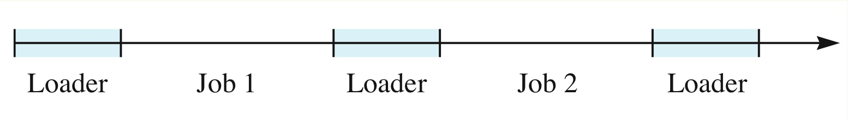
Program Termination
One processor: system alternates between user processes and OS processes.
Time spent on OS processes is overhead
OS manages the CPU using Traps
interrupt is a signal generated in hardware
when an interrupt occurs, control is given to the OS
Notes:
On a system with one processor, the system alternates between user processes and OS processes.
The time spent on OS processes is the overhead
OS manages the CPU using Traps. This interrupt is a signal generated in hardware. When an interrupt occurs, control is given to the OS.

Slide 11
Traps
Pep/8 has 5 instructions at level 5 (assembly) that are not at level 3 (machine code):
DECI
DECO
STRO
NOP (non-unary)
NOP0, NOP1, NOP2, NOP3 (all unary)
No-op instructions do nothing;
They allow reprogramming by the OS programmer
Notes:
Pep/8 has 5 instructions at level 5 (assembly) that are not at level 3 (machine code):
DECI
DECO
STRO and 5 No Ops instructions
No-op instructions do nothing;
They allow reprogramming by the OS programmer.

Slide 12
Traps
When CPU fetches instructions with one of these opcodes, hardware generates a trap:
00110 DECI Tertiary decimal input
00111 DECO Tertiary decimal output
01000 STRO Tertiary string output
001001nn NOPn Unary no-op
00101 NOP Tertiary no-op
Notes:
When CPU fetches instructions with one of these opcodes, the hardware generates a trap.
This transfers control to the OS and for these instructions the control is transferred to the code in contained in the OS to handle these operations.

Slide 13
Traps
Trap is similar to a subroutine jump (CALL)
Trap handler: code that executes when an trap is called
Trap returns control to the application by executing a return from trap (RETTR) call
Traps also called:
Software interrupts
Synchronous interrupts
Notes:
Trap is similar to a subroutine jump (CALL)
The trap handler is code that executes when an trap is called.
The trap returns control to the application by executing a return from trap (RETTR) call
Traps also called Software interrupts or Synchronous interrupts.

Slide 14
Interrupt Mechanism
When an interrupt is executed
state of running application must be stored
including all registers
State includes all OS/hardware values that application needs to continue executing
Where can we save the state?
State must be saved on a stack
interrupt could be interrupted itself
Notes:
When an interrupt is executed the state (or context) of the running application must be stored.
The state includes all registers, OS and hardware values that the application needs to continue executing.
The state must be saved on a stack, since an interrupt could, theoretically, be interrupted itself

Slide 15
PCB
Process: a program in execution
TRAP: suspends a process so OS can perform a service
Process Control Block:
Block of information in main memory that contains a copy of the interrupted process’s registers
Example: the system stack is often the PCB
Notes:
So when a program is executing and a TRAP occurs, the program is suspended so the OS can perform the process.
The state information is saved in a process control block or PCB that is pushed on the system stack.
If you review the memory map for the PEP/8, you will note that there is a system stack below the user stack that you were managing with you programs.

Slide 16
RETTR
After OS performs service, must return control of CPU to the suspended process
Use the RETTR instruction
RETTR instruction restores registers
Restoration done in hardware
Notes:
After OS performs service, the control of CPU needs to return to the suspended (ie, interrupted) process
The RETTR instruction is used for this.
It restores the state information using hardware.

Slide 17
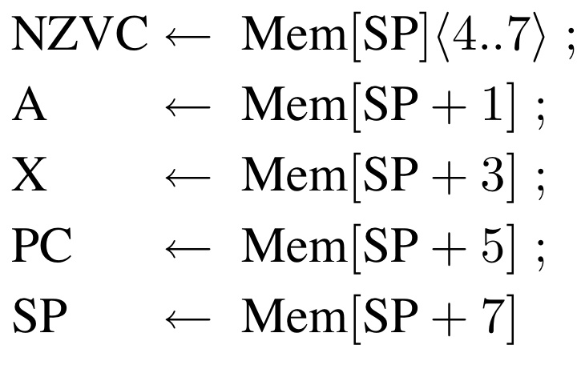
PEP/8 RETTR instruction
RETTR pops off top 9 bytes from stack
into appropriate registers
IR is not popped
Notes:
RETTR pops off the top 9 bytes from the stack into the appropriate registers. Note, the IR is not popped.

Slide 18
RETTR
Note: IR is not popped
Next instruction executed
indicated by restored PC
Last register to change is the SP
Now points to the top of the user stack
If Trap handler made changes to the PCB
Changes will be carried over
to process when restored
Process continues like before interrupt
Notes:
The instruction register is not popped because the last instruction did not need to be stored. The next instruction will be retrieved from the location that the program counter is pointing to.
Last register to change is the Stack Pointer. It now points to the top of the user stack, just like before the interrupt.

Slide 19
Loader & Trap
Assembly code for Loader & all Traps
Shown in the text
Notes:
The assembly code for the Loader and all the traps is shown in detail & discussed in the text if you want a deeper understanding of this material.
Thank you for listening and please review the Summarized lectures for Chapter 9 and 12 before taking the quiz.

